Slide 1
Absa Merchant Spend Analytics | April 2025
Consumer Sector
Consumer Sector

Slide 2
At a glance | April 2025
1
Month to month (MTM): A significant reversal in card activity.
2
MTM: Easter weekend boosted social and religious services into the top 5 categories.
3
YTD April 2025: Consumer spending trends show slower growth and resilience.
4
YTD April 2025: Digital channels driving growth, especially in food and gambling.
5
Focus: The clothing category has notably benefitted from the broader surge in online shopping.
Important: As of December 2024, there has been a significant change in our reporting. We have expanded our data sources to include both consumer issuing data and merchant transaction data. Previously, the report was solely based on merchant transaction data. This change may result in slight variations in the observed trends compared to previous reports.
The analysis presented in this report is based on the data available at the time of writing and is subject to change. Consumer spending data are inherently subject to limitations. Sampling methods and reporting lags can introduce some level of error. The findings presented in this report are based on our interpretation of the data, and different interpretations are possible. This report may contain forward-looking statements about consumer spending trends. These statements are based on assumptions and are subject to risks and uncertainties. We encourage this report’s users to carefully consider these limitations and to consult other information sources before making any decisions based on the information presented here.
Absa’s Merchant Spend Analytics: April 2025
Consumer Sector

Slide 3
1
April 2025
Month-to-month (MTM) performance

Slide 4
MTM | April 2025
The payday effect: April’s spending reversal
The brief glimmer of positive card spending and transaction volume growth observed in March 2025 proved to be fleeting. April, a month that was boosted by numerous public holidays creating long weekends, saw a significant reversal in card activity. Card spending declined by 5% and transaction volumes by a notable 7%. A key factor was the timing of the Easter weekend, which occurred before payday for many South Africans. While there was a slight uptick in spending in core categories such as food, clothing and specialty goods (including alcoholic beverages) just before Good Friday, this activity was insufficient to counteract the overall negative trend. This mirrors a pattern observed during events like Black Friday, where pre-payday timing has historically led to subdued consumer enthusiasm. Despite retailers' efforts to stimulate spending with month-long Easter specials, our data indicates that this year's Easter weekend simply didn't deliver the same boost as the previous year, when the holiday aligned more favourably with pay cycles.
The data reveals a performance that deviates sharply from typical long weekend behaviour, with restaurants experiencing a 2% decline and the tourism sector a 7% decline. What does this tell us? The figures strongly suggest a consumer base that is heavily reliant on their monthly salaries, effectively living from pay cheque to pay cheque. This reliance leads to overall muted card spending, as discretionary funds are scarce until after payday.
While the broader picture is one of decline, a few niche categories did manage to result in positive growth. Games and gaming saw a 6% increase; social and religious services rose by 3%; and clothing managed a modest 2% uptick. However, it's crucial to note that these categories typically have a low base and do not significantly influence the overall card spending landscape. The growth in social and religious services is understandable given the religious holidays in April and driven by the increasing adoption of digital payment methods by churches and NGOs.
April's spending figures serve as a sobering reminder of the prevailing economic pressures on South African households and the profound impact that payday cycles have on consumer behaviour.
Graph 1
Source: Absa’s Merchant Spend Analytics
Graph 2
Source: Absa’s Merchant Spend Analytics
Tracked card spending categories | Jan-25 | Feb-25 | Mar-25 | Apr-25
Automotive* | -5% | -18% | 24% | -2%
Books and newspaper | -4% | -30% | -4% | -9%
Building and hardware* | -20% | -16% | 25% | -7%
Business and professional services* | -19% | -8% | 17% | -11%
Care services | 15% | -28% | 22% | -5%
Clothing* | -42% | -11% | 24% | 2%
Commercial and industrial services | -2% | -13% | 22% | -5%
Digital print media | -16% | -17% | -12% | -6%
Domestic and cleaning services | 2% | -30% | 43% | 0%
Education | 494% | -38% | -48% | -28%
Electronic and computers | -15% | -10% | 17% | -15%
Food* | -20% | -8% | 17% | -5%
Funeral services | 0% | -17% | 18% | -4%
Gambling | -14% | -36% | 58% | -1%
Games and gaming | -50% | -13% | 20% | 6%
Garages* | -7% | -18% | 32% | -8%
Government | 15% | -18% | 16% | -4%
Health and beauty* | -21% | -18% | 33% | -3%
Health practitioner | 17% | -9% | 11% | -8%
Home and garden* | -28% | -7% | 20% | -11%
Medical services | 6% | -8% | 38% | -19%
NGO – social and religious services | -52% | -18% | 52% | 3%
Speciality* | -42% | -14% | 31% | -1%
Sports; outdoors and travel | -23% | -31% | 43% | -9%
Stationery and office furniture | 52% | -65% | 11% | -11%
Telecommunication | -20% | -6% | 19% | -7%
Tourism* | -9% | -22% | 32% | -7%
Transportation | 189% | 54% | 17% | -3%
Warehousing and storage | -38% | -22% | 7% | -8%
Table 1
Source: Absa’s Merchant Spend Analytics
Absa’s Merchant Spend Analytics: April 2025
Consumer Sector

Slide 5
Heat map | Day-to-day spend: April 2025
 | Top 10 core card spending categories
Date | Food % | Business and professional services % | Clothing % | Home and garden % | Garages % | Specialty % | Building and hardware % | Automotive % | Health and beauty % | Tourism %
01-04-25 | 21% | 47% | 52% | 82% | -9% | 56% | 105% | 716% | 59% | 69%
02-04-25 | 72% | 11% | 9% | 12% | -34% | 23% | 9% | 5% | 6% | 9%
03-04-25 | -18% | 11% | 8% | 2% | -3% | 17% | -5% | 12% | 5% | 5%
04-04-25 | 31% | 33% | 45% | 3% | 10% | 65% | -4% | 12% | 15% | 24%
05-04-25 | -25% | 6% | 9% | 4% | -28% | -1% | -8% | -40% | 10% | -27%
06-04-25 | -24% | -26% | -42% | -23% | -9% | -47% | -45% | -80% | -27% | 2%
07-04-25 | 22% | 68% | 42% | 89% | 54% | 64% | 201% | 1398% | 66% | 119%
08-04-25 | 4% | 20% | -9% | 17% | -8% | 18% | 16% | 13% | 21% | -1%
09-04-25 | 2% | 21% | -5% | 17% | -6% | 19% | 23% | 12% | 17% | 9%
10-04-25 | 12% | 20% | -1% | 19% | -6% | 21% | 0% | 10% | 14% | -15%
11-04-25 | 44% | 50% | 25% | 25% | 3% | 79% | 12% | 32% | 30% | 24%
12-04-25 | 17% | 16% | 13% | 7% | -34% | 14% | -7% | -37% | 8% | -42%
13-04-25 | -14% | -24% | -43% | -23% | -21% | -48% | -48% | -82% | -26% | -6%
14-04-25 | 1% | 49% | 15% | 131% | 36% | 46% | 157% | 1166% | 50% | 102%
15-04-25 | 23% | 10% | 11% | 10% | -14% | 35% | -2% | 18% | 15% | -9%
16-04-25 | 31% | 15% | 20% | 7% | -2% | 45% | 1% | 21% | 18% | -7%
17-04-25 | 93% | 32% | 69% | 19% | 19% | 124% | -2% | 38% | 44% | 9%
18-04-25 | 32% | -11% | -6% | -41% | -32% | 22% | -89% | -88% | -36% | -17%
19-04-25 | 10% | -4% | 14% | -2% | -48% | 19% | -6% | -57% | 0% | -35%
20-04-25 | -35% | -33% | -54% | -46% | -38% | -46% | -61% | -87% | -50% | -13%
21-04-25 | -1% | -2% | 14% | 41% | 6% | 17% | 36% | 71% | 8% | 12%
22-04-25 | 14% | 9% | 17% | 12% | -10% | 22% | 2% | 21% | 23% | -1%
23-04-25 | 12% | 5% | 24% | 12% | -13% | 18% | 0% | 13% | 14% | 10%
24-04-25 | 19% | 14% | 33% | 15% | -10% | 16% | -18% | 11% | 12% | 4%
25-04-25 | 35% | 24% | 46% | 25% | 3% | 65% | 2% | 27% | 29% | 9%
26-04-25 | 14% | 6% | 15% | 6% | -33% | 14% | 3% | -36% | 4% | -25%
27-04-25 | -26% | -26% | -37% | -28% | -32% | -39% | -41% | -79% | -32% | 3%
28-04-25 | -6% | -3% | 8% | 31% | -12% | 28% | 65% | 248% | 6% | 38%
29-04-25 | 8% | 13% | 22% | 16% | -17% | 28% | 18% | 26% | 34% | 16%
30-04-25 | 10% | -1% | 15% | 14% | -35% | 18% | 13% | 15% | 14% | 10%
Table 2
Source: Absa’s Merchant Spend Analytics
Absa’s Merchant Spend Analytics: April 2025
Consumer Sector

Slide 6
Heat map | MTM 2023/2024
Card spending categories | Jan'23 | Feb'23 | Mar'23 | Apr'23 | May'23 | Jun'23 | July'23 | Aug'23 | Sept'23 | Oct'23 | Nov'23 | Dec'23
Automotive | -11% | -5% | 15% | -9% | 9% | -2% | 4% | 1% | -4% | 2% | 6% | 0%
Books and newspaper | -10% | -24% | -3% | -12% | 6% | -6% | 8% | 0% | -5% | 12% | 33% | 25%
Building and hardware | -15% | -9% | 16% | -4% | 3% | -3% | 7% | 1% | -2% | 3% | 10% | -3%
Business and professional services | -20% | -5% | 18% | 4% | -7% | -1% | 8% | 2% | 3% | 0% | 9% | 19%
Care services | 15% | -14% | 12% | -18% | 32% | -9% | 1% | 4% | -5% | 7% | 5% | -10%
Commercial and industrial services | 0% | -4% | 11% | -8% | 21% | -4% | 3% | -1% | -2% | 7% | 3% | -14%
Digital print media | -27% | 11% | 8% | 7% | -8% | -33% | 11% | 27% | -11% | -8% | 46% | 5%
Domestic and cleaning services | -4% | -9% | 20% | -4% | 3% | 1% | 1% | 5% | 0% | -4% | 4% | -13%
Education | 330% | -4% | -55% | -39% | 30% | -24% | 18% | -4% | -9% | 8% | 22% | -21%
Electronic and computers | -15% | -4% | 9% | -5% | -6% | -5% | 9% | -10% | 3% | 1% | 39% | 0%
Food | -20% | -7% | 12% | 6% | -8% | 0% | 5% | -3% | 3% | 1% | 2% | 21%
Clothing | -44% | -14% | 21% | 13% | -3% | -1% | -2% | -9% | 7% | -4% | 21% | 47%
Funeral services | 4% | -7% | 16% | -10% | 14% | 6% | -5% | 3% | -6% | 1% | -1% | 0%
Gambling | -15% | -5% | 19% | 0% | -2% | 6% | 5% | 1% | 1% | 0% | 7% | 19%
Games and gaming | -58% | -3% | 14% | 12% | -15% | 13% | 3% | -10% | 8% | -2% | 18% | 85%
Garages | -12% | -8% | 7% | 1% | 1% | -8% | 5% | 1% | 7% | 3% | 0% | -3%
Government | 13% | -6% | 7% | -16% | 18% | 2% | 3% | 9% | 1% | 5% | -6% | -12%
Health and beauty | -25% | -5% | 18% | -1% | 3% | -3% | 6% | 2% | 0% | -1% | 7% | 14%
Health practitioner | 11% | 4% | 8% | -20% | 29% | -8% | 0% | 11% | -10% | 11% | 10% | -26%
Home and garden | -31% | 0% | 13% | -5% | 2% | -5% | 7% | -4% | -1% | 7% | 44% | -4%
Medical services | 2% | -1% | 31% | -23% | 8% | -7% | 0% | 9% | -6% | 9% | 5% | -12%
NGO – social and religious services | -44% | -14% | 21% | 20% | -28% | 6% | 10% | -2% | 11% | 15% | -9% | 66%
Speciality | -41% | -7% | 18% | 7% | -14% | 5% | 3% | 0% | 11% | -5% | 11% | 46%
Sports, outdoors and travel | -23% | -13% | 18% | -1% | -6% | 3% | 5% | -1% | -5% | 0% | 28% | 11%
Stationery and office furniture | 45% | -60% | -6% | -11% | 19% | -18% | 15% | 9% | -16% | 13% | 22% | 54%
Telecommunication | -36% | -4% | 12% | 1% | -2% | -3% | 3% | -2% | 3% | -2% | 3% | 24%
Tourism | -7% | -3% | 14% | -6% | -8% | -3% | 7% | 3% | 3% | 5% | 5% | 7%
Transportation | -10% | 4% | 14% | -10% | 4% | -2% | 3% | 6% | 4% | -2% | -2% | 1%
Warehousing and storage | -17% | -12% | 18% | -10% | -9% | 13% | 0% | 4% | 9% | -7% | 9% | 7%
Overall performance | -23% | -7% | 13% | 3% | -5% | -1% | 4% | -2% | 3% | 1% | 8% | 18%
Card spending categories | Jan'24 | Feb'24 | Mar'24 | Apr'24 | May'24 | Jun'24 | Jul'24 | Aug'24 | Sept'24 | Oct'24 | Nov'24 | Dec'24
Automotive | -7% | -1% | 2% | 2% | 3% | -6% | 14% | -4% | -6% | 15% | 0% | -1%
Books and newspaper | -7% | -26% | -13% | -8% | 0% | -13% | 8% | -7% | 1% | 14% | 29% | 5%
Building and hardware | -16% | -1% | 2% | 2% | 4% | -2% | 8% | 0% | -2% | 13% | 5% | 0%
Business and professional services | -22% | 0% | 14% | -14% | 3% | -4% | 4% | 6% | -3% | 7% | 9% | 12%
Care services | 21% | -13% | -5% | 11% | 0% | -7% | 13% | -1% | -4% | 10% | -1% | -3%
Commercial and industrial services | 3% | 0% | 0% | 13% | -3% | -3% | 16% | -9% | -7% | 9% | 3% | -13%
Digital print media | -25% | 9% | 88% | -33% | 20% | -11% | -35% | 30% | 40% | 66% | -39% | 8%
Domestic and cleaning services | 7% | -8% | 7% | 7% | -1% | 0% | 10% | 0% | -2% | 7% | -2% | -3%
Education | 348% | -15% | -59% | -4% | -11% | -35% | 73% | -23% | -13% | 43% | 7% | -29%
Electronic and computers | -17% | -4% | 5% | -13% | -4% | 4% | 3% | -4% | -4% | 3% | 31% | 10%
Food | -21% | -3% | 13% | -7% | 4% | -1% | 2% | 2% | -4% | 4% | 7% | 14%
Clothing | -44% | -10% | 20% | -2% | 3% | 8% | -8% | -2% | 0% | 5% | 22% | 37%
Funeral services | 8% | -6% | 3% | 5% | 7% | 4% | 4% | -2% | -10% | 12% | -8% | 7%
Gambling | -17% | -8% | 17% | 3% | 5% | -3% | 5% | 6% | -7% | 7% | 6% | 11%
Games and gaming | -58% | -2% | 17% | -6% | -3% | 8% | -5% | 1% | 2% | -3% | 21% | 76%
Garages | -10% | 2% | 7% | -2% | -2% | -6% | 4% | -2% | -6% | 2% | -2% | 5%
Government | 17% | -4% | -4% | 6% | 6% | -5% | 24% | 3% | 2% | 8% | -11% | -14%
Health and beauty | -24% | -1% | 9% | -2% | 10% | -7% | 7% | 4% | -5% | 5% | 3% | 11%
Health practitioner | 16% | 7% | -8% | 10% | 2% | -13% | 22% | -4% | -7% | 19% | -1% | -24%
Home and garden | -23% | -4% | 4% | -5% | 7% | -4% | 7% | -3% | -2% | 11% | 27% | 5%
Medical services | 5% | 8% | 12% | -8% | -3% | -10% | 13% | 0% | -6% | 15% | 1% | -10%
NGO – social and religious services | -47% | -9% | 42% | -22% | -2% | 10% | -12% | 7% | 25% | -12% | 17% | 69%
Speciality | -43% | 1% | 20% | -13% | 6% | 0% | 0% | 7% | -3% | 4% | 15% | 33%
Sports, outdoors and travel | -23% | -6% | 15% | -15% | 2% | 1% | 6% | 6% | -9% | 6% | 27% | 10%
Stationery and office furniture | 54% | -59% | -18% | 5% | 4% | -19% | 24% | -1% | -10% | 20% | 9% | 58%
Telecommunication | -23% | 0% | 10% | -7% | 2% | 0% | 5% | 1% | -4% | 8% | -1% | 17%
Tourism | -7% | -1% | 6% | -9% | -5% | 0% | 1% | 9% | 6% | 3% | -1% | 5%
Transportation | -9% | 2% | -7% | -6% | 4% | -3% | 13% | -5% | -16% | -66% | -28% | 6%
Warehousing and storage | -17% | 3% | -3% | -1% | 20% | 7% | 27% | 13% | -5% | 20% | 11% | 46%
Overall performance | -23% | -3% | 11% | -6% | 3% | -1% | 3% | 2% | -3% | 6% | 9% | 14%
Table 3
Source: Absa’s Merchant Spend Analytics
Table 4
Source: Absa’s Merchant Spend Analytics
Absa’s Merchant Spend Analytics: April 2025
Consumer Sector

Slide 7
2
April 2025
Year-to-date (YTD) performance

Slide 8
YTD | April 2025
Consumer spending trends show slower growth and resilience
YTD figures remain in positive territory, though signs of deceleration continue to emerge. Card spending recorded a modest 4% increase in April YTD 2025 compared to the same period in 2024, while transaction volumes rose by 8% (graph 8). Despite these year-on-year gains, the growth pace has slowed. Notably, the average transaction value (ATV) has settled at a 3% decline, reinforcing earlier insights that consumers are tightening their spending per transaction – potentially by purchasing fewer items or capitalising only during promotional periods. Encouragingly, card spending growth still outpaces the current inflation rate of 2.8%, suggesting a measure of resilience in consumer behaviour.
Top spending categories reflect seasonal and concerning trends
Leading spending categories YTD continued to align with seasonal drivers, such as back-to-school promotions. A standout trend is the strong performance of the warehousing and storage category, which has held the top spot for a second consecutive month, marking it as a category worth monitoring. Although this category is performing adequately, its impact remains minimal, contributing just 0.07% to the overall market share. Another consistent presence in the top five is gambling, raising red flags. As noted in previous analyses, this trend may signal deeper financial pressures, with some consumers possibly turning to gambling to supplement their income. Alternatively, the sustained growth could stem from increased accessibility through online platforms.
Digital channels drive growth, especially in food and gambling**
Online transactions continues to outpace in-store transactions. Online spending in the food category has shown particularly robust growth, surging 46% YTD April – up from 33% over the same period last year. Its share of total online spend also expanded from 17% to 21%. Meanwhile, in-store food spending declined by 1% to 2%, although it continues to account for the majority (48%) of total card-based expenditure in the category. Online gambling continues to be a significant growth category. Although its growth has decelerated, it remains on an upward trajectory, with a modest rise in transaction volume, underscoring both its enduring expansion and the serious social concerns it may pose.
Gradual recovery amid cautious optimism
According to the Absa Research team, real wage improvements are becoming evident. Additionally, they anticipate a temporary boost from upcoming withdrawals under the two-pot retirement system. Monetary policy is also expected to offer support, with the South African Reserve Bank (SARB) projected to implement a further 25-basis point interest rate cuts by July, lowering the repo rate to 7%. However, despite these supportive elements, a rebound in consumer sentiment remains elusive. Confidence has taken a notable dip, with the Bureau for Economic Research (BER) reporting a fall in the Consumer Confidence Index by 5 points to 40 in Q2. The cautious consumer outlook tempers expectations for spending recovery. Accordingly, household consumption is forecast to grow by 1.7% in 2025, reflecting modest optimism amid ongoing economic uncertainty.
Graph 3
Source: Absa’s Merchant Spend Analytics
Top 5 performing categories |  |  |  |  | Top 5 underperforming categories
Card spending categories | April YTD'25 |  |  |  | Card spending categories | April YTD'25
Warehousing and storage | 82% |  |  |  | Tourism | -1%
Transportation | 35% |  |  |  | Commercial and industrial services | -3%
Education | 22% |  |  |  | Digital print media | -8%
Government | 21% |  |  |  | Garages | -11%
Gambling | 20% |  |  |  | Books and newspaper | -20%
Table 5
Source: Absa’s Merchant Spend Analytics
Table 6
Source: Absa’s Merchant Spend Analytics
Absa’s Merchant Spend Analytics: April 2025
Consumer Sector
** Source: See heat map section, page 11 & 12, for detailed data.
Graph 4
Source: Absa’s Merchant Spend Analytics
Graph 5
Source: Absa’s Merchant Spend Analytics

Slide 9
April YTD 2025 | Card spending
Card spending categories | April YTD'22 | April YTD'23 | April YTD'24 | April YTD'25
Automotive | 10% | 10% | 8% | 5%
Books and newspaper | 12% | 17% | 5% | -20%
Building and hardware | 1% | 9% | -1% | 1%
Business and professional services | 49% | 50% | 19% | 4%
Care services | 19% | 10% | 18% | 7%
Clothing | 11% | -10% | 1% | 4%
Commercial and industrial services | 17% | 4% | 12% | -3%
Digital print media | 219% | 115% | 24% | -8%
Domestic and cleaning services | 28% | 9% | 3% | 12%
Education | 28% | 21% | 22% | 22%
Electronic and computers | 7% | 8% | 1% | 4%
Food | 6% | 15% | 4% | 4%
Funeral services | -17% | 38% | 15% | 7%
Gambling | 8% | 64% | 28% | 20%
Games and gaming | 50% | 22% | 1% | 7%
Garages | 20% | 12% | 0% | -11%
Government | -1% | 21% | 16% | 21%
Health and beauty | 2% | 12% | 8% | 6%
Health practitioner | 3% | 7% | 14% | 2%
Home and garden | -3% | 4% | 11% | 8%
Medical services | 7% | 14% | 10% | 9%
NGO – social and religious services | -5% | 19% | 5% | 12%
Speciality | 25% | 14% | 8% | 7%
Sports; outdoors and travel | 21% | 242% | 6% | 4%
Stationery and office furniture | 9% | 15% | 12% | 8%
Telecommunication | 2% | 6% | 3% | 14%
Tourism | 68% | 31% | 11% | -1%
Transportation | 67% | 18% | -7% | 35%
Warehousing and storage | 5% | -4% | 4% | 82%
Table 7
Source: Absa’s Merchant Spend Analytics
Absa’s Merchant Spend Analytics: April 2025
Consumer Sector

Slide 10
April YTD 2025 | Credit and debit cards
 | Debit card: % distribution |  |  |  |  |  |  |  | Debit card: % growth
Top 10 core card spending categories | April YTD'22 | April YTD'23 | April YTD'24 | April YTD'25 |  |  |  | Top 10 core card spending categories | April YTD'22 | April YTD'23 | April YTD'24 | April YTD'25
Automotive | 3% | 3% | 3% | 3% |  |  |  | Automotive | 10% | 10% | 8% | 4%
Building and hardware | 5% | 4% | 4% | 4% |  |  |  | Building and hardware | 1% | 7% | 0% | 0%
Business and professional services | 8% | 11% | 13% | 12% |  |  |  | Business and professional services | 54% | 53% | 17% | 2%
Clothing | 16% | 13% | 12% | 12% |  |  |  | Clothing | 10% | -12% | 0% | 4%
Food | 51% | 52% | 51% | 51% |  |  |  | Food | 7% | 16% | 2% | 3%
Garages | 5% | 5% | 5% | 4% |  |  |  | Garages | 31% | 11% | 2% | -10%
Health and beauty | 2% | 2% | 2% | 2% |  |  |  | Health and beauty | 2% | 13% | 7% | 5%
Home and garden | 6% | 5% | 6% | 6% |  |  |  | Home and garden | -1% | 4% | 10% | 8%
Speciality | 4% | 4% | 4% | 4% |  |  |  | Speciality | 24% | 12% | 8% | 6%
Tourism | 1% | 1% | 1% | 1% |  |  |  | Tourism | -58% | 36% | 12% | 3%
 |  |  |  |  |  |  |  | Overall performance | 10% | 13% | 5% | 3%
Table 8
Source: Absa’s Merchant Spend Analytics
Table 9
Source: Absa’s Merchant Spend Analytics
 | Credit card: % distribution |  |  |  |  |  |  |  | Credit card: % growth
Top 10 core card spending categories | April YTD'22 | April YTD'23 | April YTD'24 | April YTD'25 |  |  |  | Top 10 core card spending categories | April YTD'22 | April YTD'23 | April YTD'24 | April YTD'25
Automotive | 3% | 3% | 3% | 3% |  |  |  | Automotive | 9% | 10% | 9% | 8%
Building and hardware | 5% | 5% | 4% | 4% |  |  |  | Building and hardware | -1% | 13% | -4% | 5%
Business and professional services | 11% | 14% | 16% | 16% |  |  |  | Business and professional services | 37% | 44% | 25% | 8%
Clothing | 9% | 8% | 7% | 7% |  |  |  | Clothing | 22% | -2% | 5% | 8%
Food | 45% | 44% | 44% | 45% |  |  |  | Food | 4% | 14% | 10% | 9%
Garages | 9% | 9% | 8% | 7% |  |  |  | Garages | 4% | 15% | -4% | -13%
Health and beauty | 2% | 2% | 2% | 2% |  |  |  | Health and beauty | 2% | 8% | 9% | 9%
Home and garden | 8% | 7% | 8% | 8% |  |  |  | Home and garden | -9% | 5% | 15% | 10%
Speciality | 4% | 4% | 4% | 4% |  |  |  | Speciality | 26% | 20% | 8% | 9%
Tourism | 4% | 4% | 4% | 4% |  |  |  | Tourism | 469% | 28% | 11% | -4%
 |  |  |  |  |  |  |  | Overall performance | 11% | 16% | 10% | 6%
Table 11
Source: Absa’s Merchant Spend Analytics
Table 10
Source: Absa’s Merchant Spend Analytics
Absa’s Merchant Spend Analytics: April 2025
Consumer Sector

Slide 11
April YTD 2025 | Online pending
 | YTD % growth
Tracked card spending categories | April YTD'22 | April YTD'23 | April YTD'24 | April YTD'25
Automotive | 20% | 47% | 243% | 90%
Books and newspaper | -12% | 22% | 12% | 1%
Building and hardware | 24% | 21% | -6% | 3%
Business and professional services | 2% | 36% | 39% | -3%
Care services | 108% | -7% | -3% | 23%
Clothing | 85% | 31% | 24% | 8%
Commercial and industrial services | -5% | 9% | 60% | 131%
Digital print media | 399% | 144% | 27% | -10%
Domestic and cleaning services | 113% | 17% | -5% | 13%
Education | 8% | 33% | 27% | 67%
Electronic and computers | 53% | 25% | -4% | 16%
Food | 38% | -3% | 33% | 46%
Funeral services | 231% | -81% | -22% | 32%
Gambling | -33% | 254% | 70% | 36%
Games and gaming | 45% | 42% | 9% | 15%
Garages | -80% | 173% | -72% | 11%
Government | -33% | 33% | 38% | 33%
Health and beauty | 8% | 8% | 13% | 7%
Health practitioner | 0% | 6% | 43% | -20%
Home and garden | -10% | 27% | 39% | 18%
Medical services | 30% | 42% | 14% | 31%
NGO – social and religious services | -43% | 2% | 4% | 27%
Speciality | 49% | 19% | 2% | 19%
Sports; outdoors and travel | 87% | 84% | 22% | 11%
Stationery and office furniture | -27% | -29% | 19% | 16%
Telecommunication | -5% | 10% | -13% | 15%
Tourism | 78% | 26% | 15% | -2%
Transportation | 50% | 18% | -11% | 55%
Warehousing and storage | 28% | -22% | 23% | -23%
 | YTD % distribution
Tracked card spending categories | April YTD'22 | April YTD'23 | April YTD'24 | April YTD'25
Automotive | 0.15% | 0.17% | 0.47% | 0.75%
Books and newspaper | 0.47% | 0.46% | 0.40% | 0.34%
Building and hardware | 0.67% | 0.65% | 0.47% | 0.41%
Business and professional services | 17.69% | 19.26% | 20.99% | 17.01%
Care services | 0.00% | 0.00% | 0.00% | 0.00%
Clothing | 7.40% | 7.75% | 7.57% | 6.80%
Commercial and industrial services | 0.03% | 0.03% | 0.04% | 0.07%
Digital print media | 1.11% | 2.17% | 2.15% | 1.61%
Domestic and cleaning services | 0.04% | 0.03% | 0.03% | 0.02%
Education | 1.58% | 1.68% | 1.68% | 2.34%
Electronic and computers | 1.87% | 1.87% | 1.42% | 1.37%
Food | 21.29% | 16.46% | 17.15% | 20.97%
Funeral services | 0.00% | 0.00% | 0.00% | 0.00%
Gambling | 1.08% | 3.06% | 4.07% | 4.62%
Games and gaming | 0.69% | 0.79% | 0.68% | 0.65%
Garages | 0.03% | 0.07% | 0.01% | 0.01%
Government | 1.70% | 1.80% | 1.95% | 2.17%
Health and beauty | 0.32% | 0.28% | 0.25% | 0.22%
Health practitioner | 0.05% | 0.04% | 0.05% | 0.03%
Home and garden | 20.39% | 20.66% | 22.49% | 22.12%
Medical services | 0.59% | 0.67% | 0.60% | 0.66%
NGO – social and religious services | 0.19% | 0.16% | 0.13% | 0.14%
Speciality | 3.24% | 3.08% | 2.48% | 2.46%
Sports; outdoors and travel | 0.43% | 0.64% | 0.61% | 0.56%
Stationery and office furniture | 0.02% | 0.01% | 0.01% | 0.01%
Telecommunication | 2.60% | 2.28% | 1.57% | 1.51%
Tourism | 7.75% | 7.82% | 7.05% | 5.80%
Transportation | 8.62% | 8.12% | 5.69% | 7.35%
Warehousing and storage | 0.00% | 0.00% | 0.00% | 0.00%
Table 12
Source: Absa’s Merchant Spend Analytics
Table 13
Source: Absa’s Merchant Spend Analytics
Absa’s Merchant Spend Analytics: April 2025
Consumer Sector

Slide 12
April YTD 2025 | In-store Spending
 | % growth
Tracked card spending categories | April YTD'22 | April YTD'23 | April YTD'24 | April YTD'25
Automotive | 10% | 10% | 7% | 3%
Books and newspaper | 26% | 15% | 1% | -32%
Building and hardware | 1% | 9% | -1% | 1%
Business and professional services | 63% | 53% | 16% | 5%
Care services | 19% | 10% | 18% | 7%
Clothing | 10% | -12% | -1% | 4%
Commercial and industrial services | 17% | 4% | 12% | -6%
Digital print media | 82% | 53% | 13% | -2%
Domestic and cleaning services | 25% | 8% | 4% | 12%
Education | 36% | 17% | 20% | 4%
Electronic and computers | 2% | 6% | 2% | 2%
Food | 6% | 16% | 3% | 2%
Funeral services | -17% | 38% | 15% | 7%
Gambling | 26% | 20% | -1% | 2%
Games and gaming | 53% | 11% | -4% | 2%
Garages | 20% | 12% | 0% | -11%
Government | 7% | 19% | 12% | 18%
Health and beauty | 2% | 12% | 8% | 6%
Health practitioner | 3% | 7% | 14% | 3%
Home and garden | 0% | -4% | -2% | 2%
Medical services | 5% | 12% | 10% | 7%
NGO –social and religious services | 26% | 25% | 5% | 7%
Speciality | 23% | 13% | 8% | 6%
Sports; outdoors and travel | 14% | 270% | 4% | 3%
Stationery and office furniture | 9% | 15% | 12% | 8%
Telecommunication | 4% | 5% | 6% | 14%
Tourism | 61% | 35% | 9% | -1%
Transportation | 583% | 21% | 15% | -69%
Warehousing and storage | 5% | -4% | 4% | 82%
 | % distribution
Tracked card spending categories | April YTD'21 | April YTD'22 | April YTD'23 | April YTD'24 | April YTD'25
Automotive | 2.76% | 2.73% | 2.64% | 2.71% | 2.73%
Books and newspaper | 0.07% | 0.08% | 0.09% | 0.08% | 0.06%
Building and hardware | 5.03% | 4.58% | 4.39% | 4.19% | 4.14%
Business and professional services | 5.09% | 7.50% | 10.12% | 11.29% | 11.59%
Care services | 0.02% | 0.02% | 0.02% | 0.02% | 0.02%
Clothing | 14.23% | 14.11% | 10.94% | 10.41% | 10.56%
Commercial and industrial services | 0.20% | 0.21% | 0.19% | 0.21% | 0.19%
Digital print media | 0.03% | 0.04% | 0.06% | 0.06% | 0.06%
Domestic and cleaning services | 0.04% | 0.04% | 0.04% | 0.04% | 0.04%
Education | 0.30% | 0.38% | 0.39% | 0.45% | 0.45%
Electronic and computers | 1.09% | 1.01% | 0.94% | 0.92% | 0.91%
Food | 50.06% | 47.87% | 49.04% | 48.47% | 48.39%
Funeral services | 0.07% | 0.06% | 0.07% | 0.07% | 0.08%
Gambling | 0.32% | 0.36% | 0.38% | 0.37% | 0.36%
Games and gaming | 0.08% | 0.11% | 0.11% | 0.10% | 0.10%
Garages | 5.43% | 5.90% | 5.84% | 5.63% | 4.90%
Government | 0.95% | 0.92% | 0.97% | 1.05% | 1.21%
Health and beauty | 2.37% | 2.18% | 2.15% | 2.22% | 2.29%
Health practitioner | 0.71% | 0.66% | 0.63% | 0.69% | 0.69%
Home and garden | 5.18% | 4.67% | 3.95% | 3.74% | 3.73%
Medical services | 0.63% | 0.60% | 0.59% | 0.63% | 0.66%
NGO – social and religious services | 0.04% | 0.04% | 0.05% | 0.05% | 0.05%
Speciality | 3.07% | 3.43% | 3.43% | 3.57% | 3.68%
Sports; outdoors and travel | 0.18% | 0.19% | 0.62% | 0.62% | 0.63%
Stationery and office furniture | 0.27% | 0.27% | 0.27% | 0.29% | 0.31%
Telecommunication | 1.23% | 1.15% | 1.07% | 1.09% | 1.20%
Tourism | 0.49% | 0.71% | 0.85% | 0.89% | 0.86%
Transportation | 0.02% | 0.10% | 0.10% | 0.12% | 0.03%
Warehousing and storage | 0.05% | 0.05% | 0.04% | 0.04% | 0.07%
Table 14
Source: Absa’s Merchant Spend Analytics
Table 15
Source: Absa’s Merchant Spend Analytics
Absa’s Merchant Spend Analytics: April 2025
Consumer Sector

Slide 13
3
Focus: Clothing category

Slide 14
Focus | Clothing category
Navigating economic headwinds and evolving consumer trends
The clothing category stands as a significant pillar in card spending, holding the third-largest share of card transactions at a substantial 10% of the market YTD. However, recent data reveals a dynamic landscape influenced by economic pressures and shifting consumer behaviours.
Seasonal peaks and economic tides
Purchase patterns within the clothing sector are heavily driven by seasonality. Key periods such as the end-of-season sales, Black Friday and the festive season consistently trigger spikes in card spending. Yet, beyond these predictable cycles, the category's performance is intrinsically linked to the broader economic climate. In September 2021, the South African Reserve Bank began increasing interest rates to combat surging inflation. South African households were already grappling with stagnant wages, rising utility costs, and the ongoing disruptions of loadshedding - amplifying financial pressure and reducing disposable income. Our internal data indicates that this policy shift may have led to a notable change in spending habits. The financial strain became evident in late 2022, culminating in a marked decline in spending by August (see graph 6). Since then, the category has not recovered its peak growth rate of 22% recorded in 2022. Nonetheless, performance in 2025 has remained steadily positive on a month-to-month basis, mirroring trends seen in 2022. While it's too early to declare a recovery, these signs suggest the category may be gradually regaining some of its former strength.
The rise of fast fashion and digital shifts
The decline in market share in this category for traditional retailers can be attributed to a myriad of factors: the challenging macroeconomic environment, evolving consumer preferences and the influence of fast fashion trends. Online international fast fashion platforms have increasingly cannibalised market share. Consumers, in their pursuit of trendy yet affordable fashion, are gravitating towards these platforms, intensifying the competitive landscape for established brands. This places traditional retailers in a precarious position, forcing them to balance the protection of profit margins with the imperative of maintaining product quality.
Despite these challenges, the clothing category has notably benefited from the broader surge in online shopping. While the double-digit growth in online sales is now normalising (graph 7), it continues to contribute positively. In contrast, in-store shopping has shown no growth as of 2024, underscoring the ongoing shift towards digital retail channels.
In closing, adapting to the persistent effects of economic tightening, the relentless rise of fast fashion and the continued normalisation of online shopping will be crucial for traditional brands aiming to sustain growth and profitability in this highly competitive market.
Graph 6
Source: Absa’s Merchant Spend Analytics
Graph 7
Source: Absa’s Merchant Spend Analytics
Absa’s Merchant Spend Analytics: April 2025
Consumer Sector

Slide 15
4
The team

Slide 16
Consumer Sector team
Isana Cordier: Managing Executive, Coverage Head: Consumer Sector
isana.cordier@absa.africa
Absa CIB
Chipo Butayi: Senior Coverage Banker
Chipo.masawi@absa.africa
Absa CIB
Chriszelle Joseph: Senior Coverage Banker
chriszelle.joseph@absa.africa
Absa CIB
Mpho Dube: Senior Coverage Banker
mpho.dube@absa.africa
Absa CIB
Basil Howard: Coverage Banker
basil.howard@absa.africa
Absa CIB
Dale Spencer: Senior Coverage Banker
dale.spencer@absa.africa
Absa CIB
Adrian Moon: Senior Coverage Banker
adrian.moon@absa.africa
Absa CIB
Zama Nkalanga: Senior Sector Analyst
zama.nkalanga@absa.africa
Absa CIB
Palesa Manone: Sector Analyst
palesa.manone@absa.africa
Absa CIB
Digital Data Products team
Shalain Gopal: Head: Digital Data
shalain.gopal@absa.africa
Absa CIB
Mahlatse Raseala: Specialist Product Engineer
mahlatse.raseala@absa.africa
Absa CIB
John Leuner: Lead Product Engineer (PocketFlow)
john.leuner@absa.africa
Absa CIB
Sifiso Mokaile: Business Technical Data Analyst | Client Data Products
Ashley Morebudi: Specialist Data Scientist | Client Data Products
Jonas Moapolela: Frontend Engineer | PocketFlow
Absa’s Merchant Spend Analytics: March 2025
Consumer Sector

Slide 17
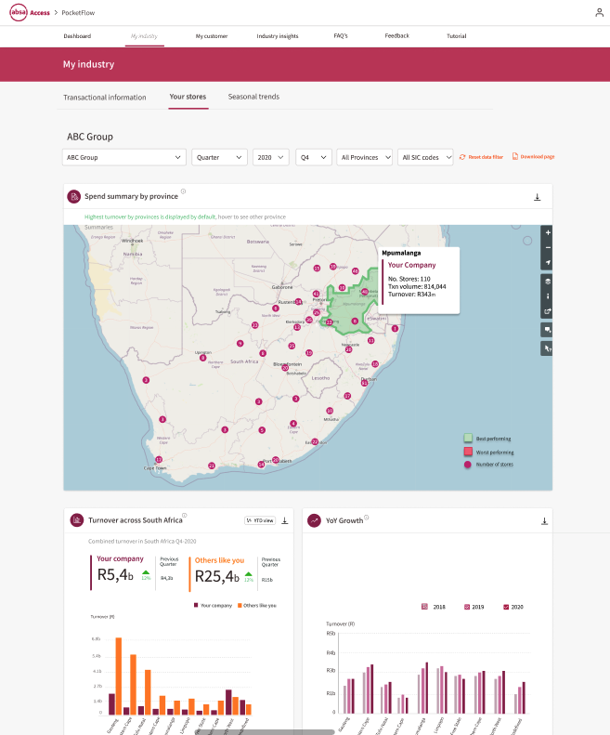
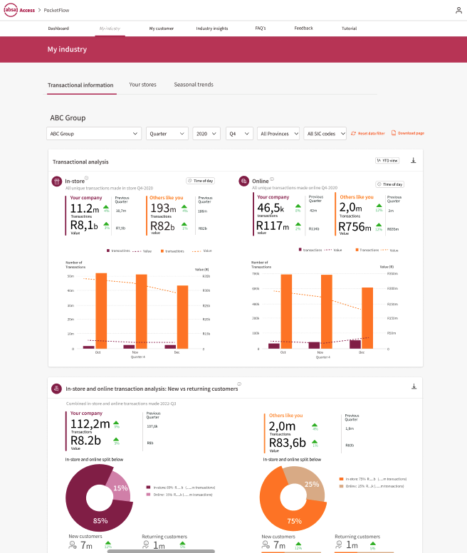
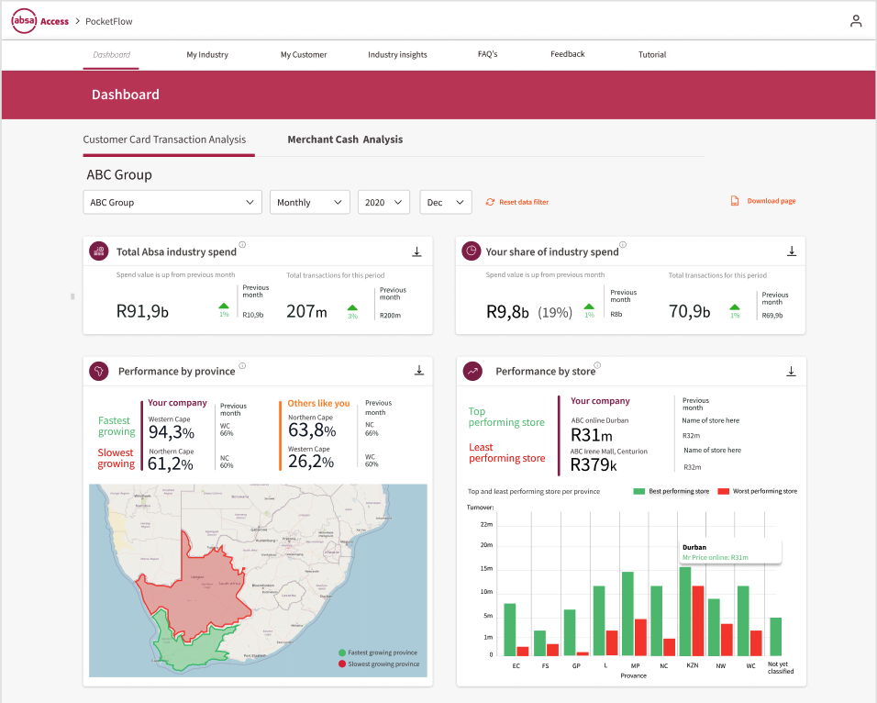
Spend analytics: PocketFlow
A big-data web-based tool that takes you beyond the limitations of traditional banking
Do you know who your customers are? What their spend behaviour at your store is? Or how you compare to competitors?
Now you can, with Absa’s spend analytics tool, PocketFlow. This tool is designed to help you understand your customers better and optimise your business strategies.
The tool’s interactive customer visualisations allow you to better understand your business’s performance, further strengthening actionable insights. PocketFlow is a self-service tool that doesn’t involve any complicated installation processes, nor does it require specialist IT skills to implement or use.
Start your PocketFlow spend analytics journey today!
Two available offerings:
PocketFlow (for large corporates): Speak to your Business Banker today
PocketFlow Lite (for small and medium enterprises): Register on the Absa Merchant Access Online (AMAO) portal at https://absamerchantaccessonline.absa.co.za

Slide 18
Absa Group Limited Reg No 1986/003934/06. All rights reserved.
Registered office: 15 Alice Lane, Sandton, 2146, Gauteng, South Africa.
The contents of this document may not be distributed unlawfully. Copyright subsists in
this brochure. No part of this work may be reproduced in any form or by any means
without Absa Bank Limited’s written permission. Any unauthorised reproduction of
this work will constitute a copyright infringement and render the doer liable under
both civil and criminal law. While every effort has been made to ensure that the
information published in this brochure is accurate, Absa Bank Limited, the editors,
publishers and printers take no responsibility for any loss or damage suffered
by any person as a result of the reliance on the information contained therein.
Terms and conditions apply. Absa is an Authorised Financial Services Provider and a Registered Credit Provider.
You should check that the information provided in the brochure is still correct and relevant before you use it for your purposes.
Terms and conditions apply.
Authorised Financial Services Provider Registered Credit Provider Reg No NCRCP7

