Slide 1
MSCI South Africa Annual Property Index
December 2024
Presented on 9th April 2025

Slide 2
MSCI South Africa Annual Index composition and returns
Source: MSCI

Slide 3
MSCI Real Estate South African universe contributors
Unlevered, directly held real estate
407
BN
Notes:
Thank you to all the contributors, not so much in giving data to us - technology advancements have made part that very simple these days but rather for the validation process they go through with us. MSCI processes all the data as per the MSCI taxonomy to ensure data quality and benchmark credibility and this can be rigorous at times.

Slide 4
The property investment market is growing again after recent the slowdown
CRE Investment
Source: MSCI
Notes:
The MSCI index has growth substantially since it began in 1997 not so much because out coverage has changed, MSCI and before that IPD always covered about 60-70% of the commercial property market excluding owner-occupied property.
This a reflection of how the investment market has grown in south Africa over the last 28 years, peaking in 2018 and then dropping off owning both to both of value as well as institutional investors selling off non-core properties to either owner occupiers or small private investors. Since 2022, investment into real estate has begin to climb again. Again, because values are increases but net invest into the sector has swung to being positive.
The shows the commercial property invest is starting to build some momentum

Slide 5
Capital expenditure picked-up in 2024 to above the 10YR average
CRE Investment
Source: MSCI
Notes:
Here we see that capex expressed both per m2 and as % of value and one can see the pick-up.
The 10-year average have the covid so one can argue that we need to see a lot more before we can celebrate it, and that probably true but unlikely until we see real economic growth.
Interesting you can see the boom when offices where being built through 2004 right through to 2016, and the spoke in 2016 is when MOA was built.

Slide 6
Commercial property transactions higher in 2024 than pervious years
CRE Investment
SOUTH AFRICAN investment property deal volume (ZAR)
Source: MSCI RCA
Notes:
Transactions values have picked up in 2024- we recorded 136 commercial property deal ranging for 3mill for a small warehouse in n only industrial node to a large retail centre for over 5bill with a whole lot of variation in between.
The net effect shown on the right-hand slide graph is that net aquations was positive in terms of value. More capital flowing in than out.

Slide 7
Total Return of direct, ungeared property investment tracks GDP growth
CRE Investment
Source: MSCI, Absa
Notes:
Total return on direct and ungeared property investment tracks GDP growth very closely. AS growth waned through 2011 and 2018, returns declined. They bumped about throug2020 and 2021, through covid and then picked up some 2022 as GDP growth as improved. However, until GDP growth improves and the magic number, I believe is 2,5%, we are unlikely to see return continue to track sideways

Slide 8
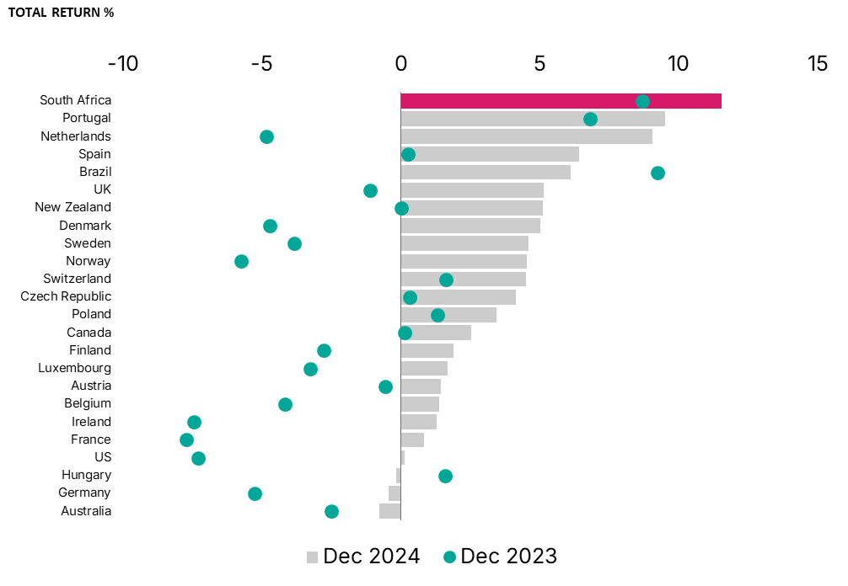
South Africa recorded the highest total return globally in 2024
CRE Investment
Source: MSCI
Notes:
If we compare SA returns to other markets where MSCI published property indexes, South Africa , in Local currency, outperformed substantially.
All markets have improved from 20203 benefiting from the declining interest rates, Hungry being the only exception.

Slide 9
Total Return at 11.9% is the highest it has been since 2015
South Africa Headline
Standing Investment
Source: MSCI

Slide 10
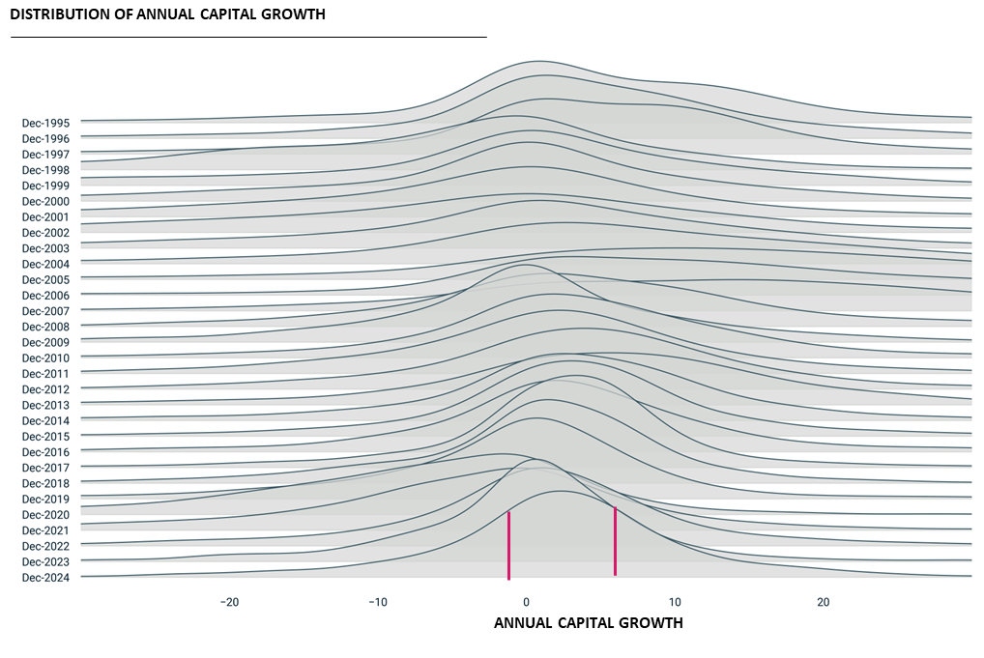
Distribution of Capital Growth moved to the right in 2024
All Property
3.0
25th
75th
Source: MSCI South Africa Annual Property Index
Details
Notes:
Spreads shows that whole market has improved, not just the biggest assets by value that are improving but the tail is also moving up. This talks to the market starting to gain some momentum

Slide 11
Capital values have recovered while at the same time, income return is above the 10-year average
All Property
Source: MSCI
Notes:
Unpacking the two components of total return, i.e. Income return and capital growth we have seen in both. Income has growth faster than values even while values have grown which puts the sector in a good position for income growth going forward
If we look at the period from 2017 through to 2019, the inverse was true and that why we got values needed a bit of a reset which is what happened in 2020, regardless of covid

Slide 12
Transactional values are comparable to the assessed values
Source: MSCI
Notes:
Here we are comparing transactions values to the assessed values that the index uses to calculate returns. Across the three retail property types where we saw transactions, the sale price was within rage of the assed values. The regional centres are on the lower end but that was expected as those were the Rebosis regional shopping centres that were sold were.
Factors like location, asset quality, vacancy, lease expiry profile will impact that sale price so we don’t expect it to be exactly on the 50th percentile but we do want it to be with the range.

Slide 13
Net Income Growth - 50% of the market is achieving real growth
Same Store
Source: MSCI
Notes:
We tried to answer the question, how healthy is the NIG withing the assets that we measure, and the answer is that at least half of the assets are achieving real growth. Its similar to where we were in the pre-covid period and if we go further back to the 2004-2007 growth period, that really where we want to be as a sector but we are improving

Slide 14
Tenant demand is static overall but ticking up at the top of the spread
All Property
Standing Investments
Source: MSCI
Notes:
This is the spread of vacancy. Vacancy is always intereing because Is the leasing indicator of where the market might go.
Overall vacancies are static, but as the sread widens is does show that the lower end of the market is ticking up.

Slide 15
Rental growth is inline with inflation
All Property
Same Store
Source: MSCI
Same Store
Notes:
Basic rental growth, which for us is the measure of rental income earned from one period to another, is aligned with inflation. The spread is widening showing that there are parts of the market where rental growth is the average quite substantially

Slide 16
Gross Cost to Income ratio also remained static
All Property
Same Store
Source: MSCI
Notes:
The gross cost to income ratio, and this is calculated as gross on gross, remined static at 4,28%
It grw substantially through 2017 to 2022 but in the last two years, it has stayed flat. This is very encouraging because it is a consequence of improved rentals and slowing costs growth

Slide 17
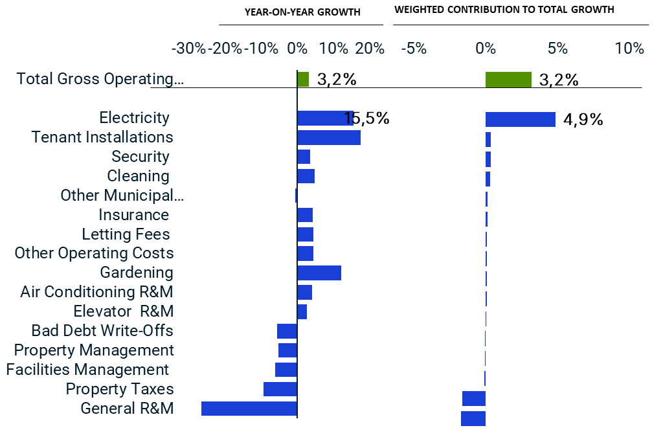
Gross operating cost growth was largely driven by Electricity cost
All Property
Same Store
Source: MSCI
Notes:
Cost growth was below inflation growing at 3,2%. The biggest driver of that cost growth was electricity.
The right-hand side chart, we weighted the costs by the value of the cost and its contribution to total costs. Electricity has the biggest contracting impact, but off setting that was a decrease in rates, which might shock many of you, and on general R&M. the R&M and is diesel and running generators. With alternatives in many centres and well as the lack of loadshedding in 2024 compared to 2023, this stand to reason.
Increasing TI, also stand to reason as owners are fighting hard and spending more to get tenants into their building.

Slide 18
Total Return improved for each sector - industrial showing the best returns, again
Sector Analysis
Standing Investments
Source: MSCI

Slide 19
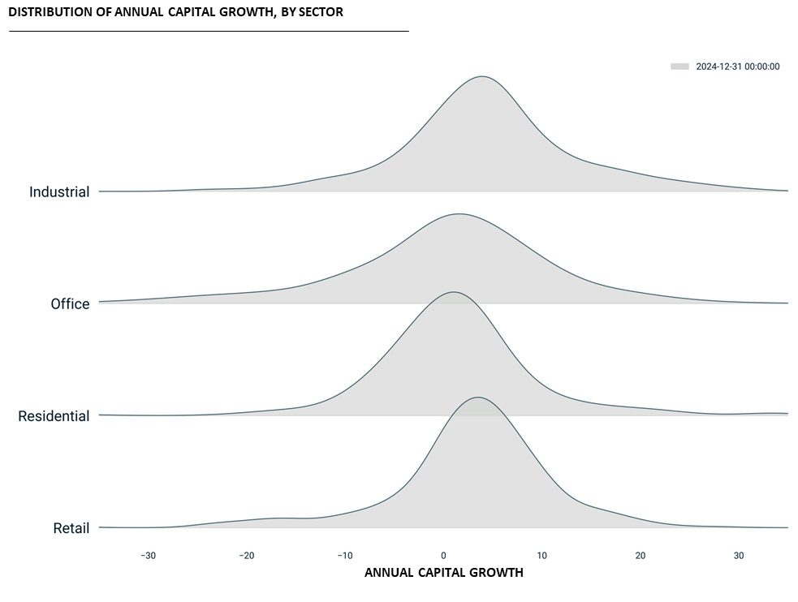
Spread of capital growth is narrower for retail and industrial than for office and residential. The tail for offices is longer.
Sector Analysis
5.0
0.4
2.1
3.4
Standing Investments
25th
75th
Source: MSCI

Slide 20
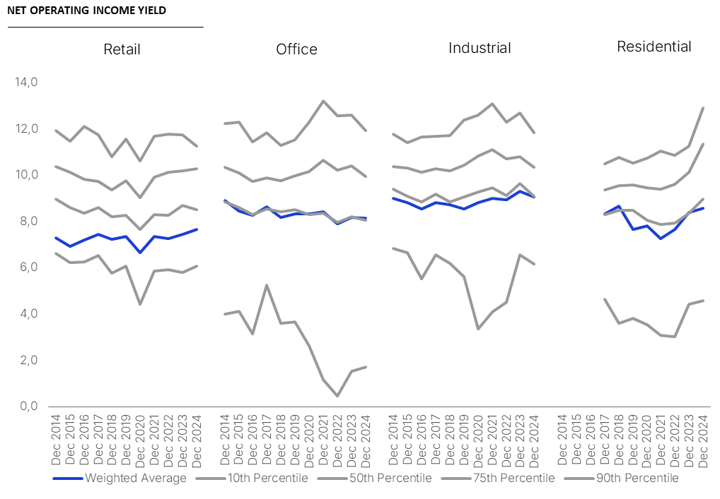
Net Operating Income Yields stable at the core – but a wide range around it
Sector Analysis
Standing Investments
Source: MSCI

Slide 21
Vacancies at the top end increase in all sectors except retail showing weaking demand
Source: MSCI
Source: MSCI
Standing Invesments

Slide 22
Office rentals declining while other sectors delivered real growth
Sector Analysis
Same Store
Source: MSCI
Notes:
Still distress in the office market

Slide 23
Sales growth in equilibrium with rental growth makes for tenant sustainability
Retail Performance Benchmarking
Source: SAPOA Retail Trends Report Q4 2024, Author MSCI

Slide 24
Trading Density growth slowed but inline with inflation
Retail Performance Benchmarking
Source: SAPOA Retail Trends Report Q4 2024, Author MSCI

Slide 25
Only retail’s Net Operating Income growth kept up with inflation
Sector Analysis
Same Store
Source: MSCI

Slide 26
Gross Cost to Income Ratio stable but for industrial where it increased slightly
Sector Analysis
Same Store
Source: MSCI

Slide 27
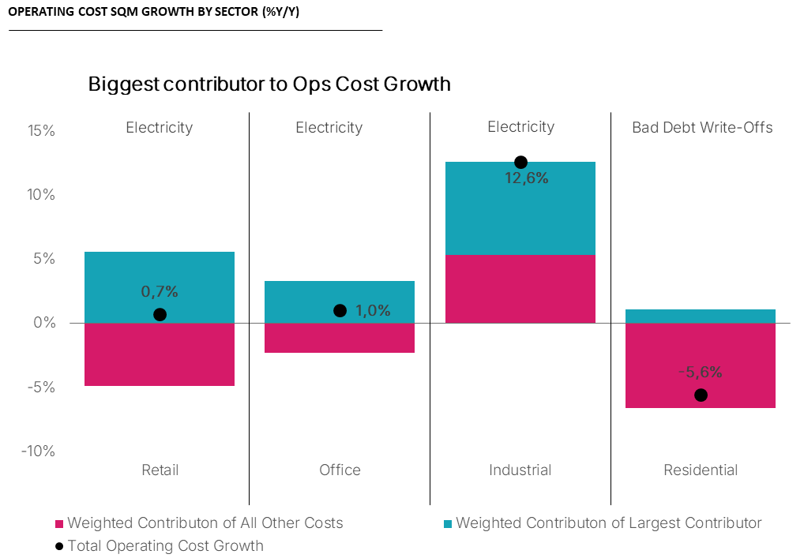
Electricity is the largest contributor to operating cost growth, except for Residential where tenants pays directly
Sector Analysis
Same Store
Source: MSCI

Slide 28
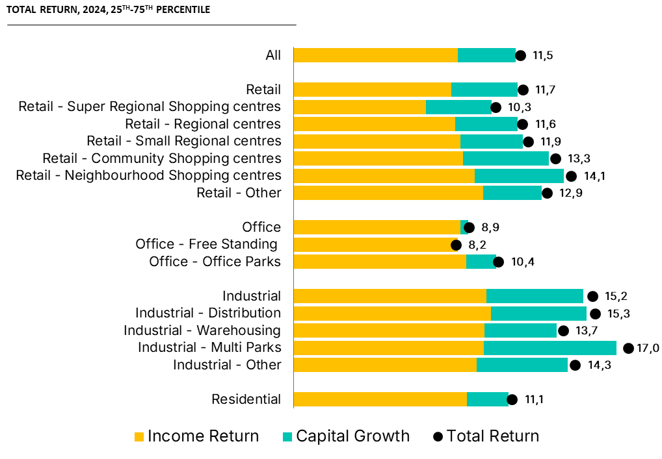
Smaller format retail and industrial segments were among best performing segments
Property Type Analysis
Standing Investments
Source: MSCI

Slide 29
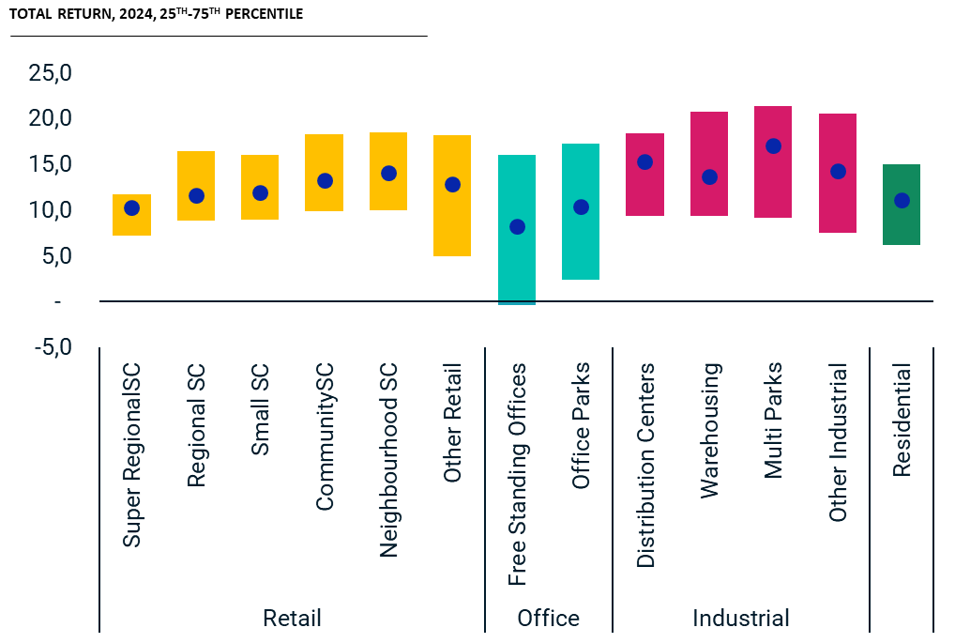
Range of returns largest in the office sector
Property Type Analysis
Standing Investments
Source: MSCI

Slide 30
Coastal cities show better returns than inland cities
Geographical Analysis
Standing Investments
Source: MSCI

Slide 31
Fundamentals are stronger in coastal locations
Source: MSCI
Standing Investments; Same Store

Slide 32
Township and Rural retail have seen the highest capital growth but also a decline in income return
Geographical Analysis
Standing Investments
Source: MSCI

Slide 33
Fundamentals don’t favour any one location
Source: MSCI
Standing Investments; Same Store

Slide 34
Summary
South African direct, ungeared property returns are the highest they have been since 2015, at 11.5%
Both capital growth and income returns have increased compared to previous years
Rental growth is exceeding inflation in all sectors except offices, while vacancies remain flat throughout
Net Income growth - only retail is on par, while all other sectors have show growth below inflation
The outlook for 2025 is positive. Challenges with electricity supply and costs, water shortages, and geo-political turmoil could dampen growth prospects.

Slide 35
About MSCI
MSCI is a leading provider of critical decision support tools and services for the global investment community. With over 50 years of expertise in research, data and technology, we power better investment decisions by enabling clients to understand and analyze key drivers of risk and return and confidently build more effective portfolios. We create industry-leading research-enhanced solutions that clients use to gain insight into and improve transparency across the investment process. To learn more, please visit www.msci.com.

Slide 36
Notice and Disclaimer
This document and all of the information contained in it, including without limitation all text, data, graphs, charts (collectively, the “Information”) is the property of MSCI Inc. or its subsidiaries (collectively, “MSCI”), or MSCI’s licensors, direct or indirect suppliers or any third party involved in making or compiling any Information (collectively, with MSCI, the “Information Providers”) and is provided for informational purposes only. The Information may not be modified, reverse-engineered, reproduced or redisseminated in whole or in part without prior written permission from MSCI. All rights in the Information are reserved by MSCI and/or its Information Providers.
The Information may not be used to create derivative works or to verify or correct other data or information. For example (but without limitation), the Information may not be used to create indexes, databases, risk models, analytics, software, or in connection with the issuing, offering, sponsoring, managing or marketing of any securities, portfolios, financial products or other investment vehicles utilizing or based on, linked to, tracking or otherwise derived from the Information or any other MSCI data, information, products or services.
The user of the Information assumes the entire risk of any use it may make or permit to be made of the Information. NONE OF THE INFORMATION PROVIDERS MAKES ANY EXPRESS OR IMPLIED WARRANTIES OR REPRESENTATIONS WITH RESPECT TO THE INFORMATION (OR THE RESULTS TO BE OBTAINED BY THE USE THEREOF), AND TO THE MAXIMUM EXTENT PERMITTED BY APPLICABLE LAW, EACH INFORMATION PROVIDER EXPRESSLY DISCLAIMS ALL IMPLIED WARRANTIES (INCLUDING, WITHOUT LIMITATION, ANY IMPLIED WARRANTIES OF ORIGINALITY, ACCURACY, TIMELINESS, NON-INFRINGEMENT, COMPLETENESS, MERCHANTABILITY AND FITNESS FOR A PARTICULAR PURPOSE) WITH RESPECT TO ANY OF THE INFORMATION.
Without limiting any of the foregoing and to the maximum extent permitted by applicable law, in no event shall any Information Provider have any liability regarding any of the Information for any direct, indirect, special, punitive, consequential (including lost profits) or any other damages even if notified of the possibility of such damages. The foregoing shall not exclude or limit any liability that may not by applicable law be excluded or limited, including without limitation (as applicable), any liability for death or personal injury to the extent that such injury results from the negligence or willful default of itself, its servants, agents or sub-contractors.
Information containing any historical information, data or analysis should not be taken as an indication or guarantee of any future performance, analysis, forecast or prediction. Past performance does not guarantee future results.
The Information should not be relied on and is not a substitute for the skill, judgment and experience of the user, its management, employees, advisors and/or clients when making investment and other business decisions. All Information is impersonal and not tailored to the needs of any person, entity or group of persons.
None of the Information constitutes an offer to sell (or a solicitation of an offer to buy), any security, financial product or other investment vehicle or any trading strategy.
It is not possible to invest directly in an index. Exposure to an asset class or trading strategy or other category represented by an index is only available through third party investable instruments (if any) based on that index. MSCI does not issue, sponsor, endorse, market, offer, review or otherwise express any opinion regarding any fund, ETF, derivative or other security, investment, financial product or trading strategy that is based on, linked to or seeks to provide an investment return related to the performance of any MSCI index (collectively, “Index Linked Investments”). MSCI makes no assurance that any Index Linked Investments will accurately track index performance or provide positive investment returns. MSCI Inc. is not an investment adviser or fiduciary and MSCI makes no representation regarding the advisability of investing in any Index Linked Investments.
Index returns do not represent the results of actual trading of investible assets/securities. MSCI maintains and calculates indexes, but does not manage actual assets. Index returns do not reflect payment of any sales charges or fees an investor may pay to purchase the securities underlying the index or Index Linked Investments. The imposition of these fees and charges would cause the performance of an Index Linked Investment to be different than the MSCI index performance.
The Information may contain back tested data. Back-tested performance is not actual performance, but is hypothetical. There are frequently material differences between back tested performance results and actual results subsequently achieved by any investment strategy.
Constituents of MSCI equity indexes are listed companies, which are included in or excluded from the indexes according to the application of the relevant index methodologies. Accordingly, constituents in MSCI equity indexes may include MSCI Inc., clients of MSCI or suppliers to MSCI. Inclusion of a security within an MSCI index is not a recommendation by MSCI to buy, sell, or hold such security, nor is it considered to be investment advice.
Data and information produced by various affiliates of MSCI Inc., including MSCI ESG Research LLC and Barra LLC, may be used in calculating certain MSCI indexes. More information can be found in the relevant index methodologies on www.msci.com.
MSCI receives compensation in connection with licensing its indexes to third parties. MSCI Inc.’s revenue includes fees based on assets in Index Linked Investments. Information can be found in MSCI Inc.’s company filings on the Investor Relations section of www.msci.com.
MSCI ESG Research LLC is a Registered Investment Adviser under the Investment Advisers Act of 1940 and a subsidiary of MSCI Inc. Except with respect to any applicable products or services from MSCI ESG Research, neither MSCI nor any of its products or services recommends, endorses, approves or otherwise expresses any opinion regarding any issuer, securities, financial products or instruments or trading strategies and MSCI’s products or services are not intended to constitute investment advice or a recommendation to make (or refrain from making) any kind of investment decision and may not be relied on as such. Issuers mentioned or included in any MSCI ESG Research materials may include MSCI Inc., clients of MSCI or suppliers to MSCI, and may also purchase research or other products or services from MSCI ESG Research. MSCI ESG Research materials, including materials utilized in any MSCI ESG Indexes or other products, have not been submitted to, nor received approval from, the United States Securities and Exchange Commission or any other regulatory body.
Any use of or access to products, services or information of MSCI requires a license from MSCI. MSCI, Barra, RiskMetrics, IPD and other MSCI brands and product names are the trademarks, service marks, or registered trademarks of MSCI or its subsidiaries in the United States and other jurisdictions. The Global Industry Classification Standard (GICS) was developed by and is the exclusive property of MSCI and S&P Global Market Intelligence. “Global Industry Classification Standard (GICS)” is a service mark of MSCI and S&P Global Market Intelligence.
Privacy notice: For information about how MSCI collects and uses personal data, please refer to our Privacy Notice at https://www.msci.com/privacy-pledge.

Slide 37
x
Source: MSCI

Slide 38
Vacancies stable for each sector except for residential where there was an uptick
Sector Analysis
Standing Investments
Source: MSCI

Slide 39
Operating Cost growth accelerated post covid but has slowed in 2024
Sector Analysis
Same Store
Source: MSCI

